Slide 1
Lecture 14
Unix system calls: low level I/O, File system directories, inodes, process and interrupts related system calls

Slide 2
What is system calls in Unix system
A system call is a programming interface between a user program and the operating system kernel. It allows user-level applications to request services (like reading a file, creating a process, or communicating over the network) from the kernel

Slide 3
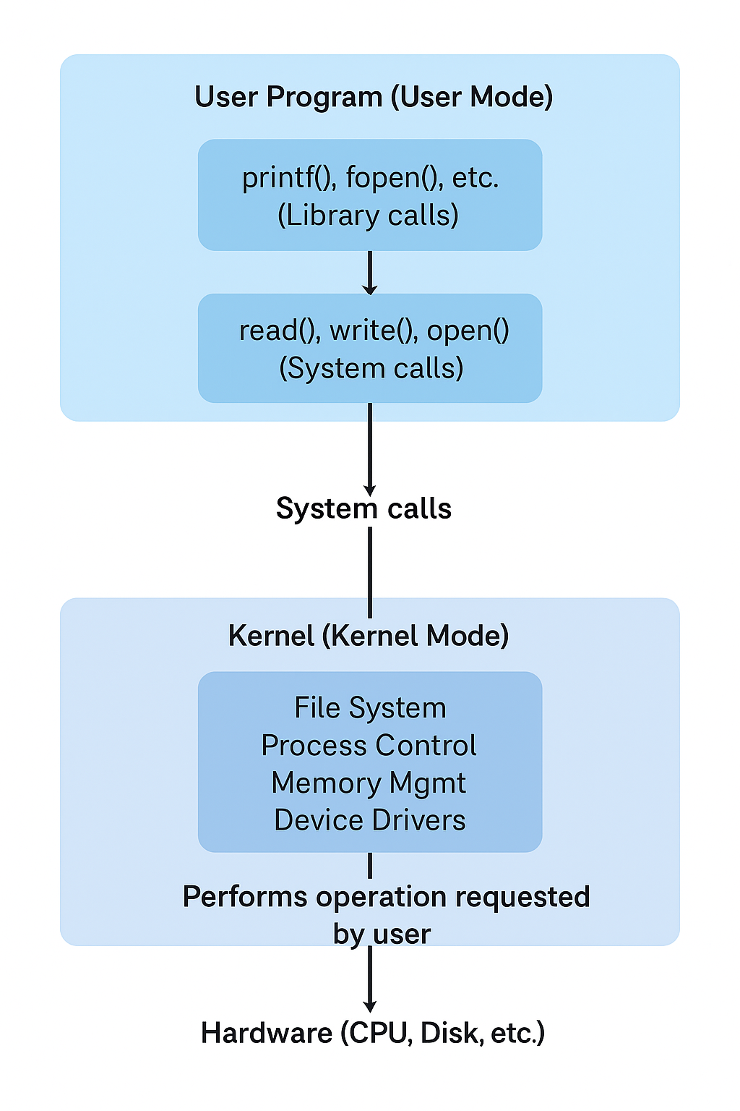

Slide 4
Low level system calls
System Call | Description
open() | Opens a file and returns a file descriptor.
read() | Reads data from a file descriptor into a buffer.
write() | Writes data from a buffer to a file descriptor.
lseek() | Moves the file offset (read/write pointer).
close() | Closes an open file descriptor.

Slide 5
File system related system calls
System Call | Description
mkdir() | Creates a new directory.
rmdir() | Removes an empty directory.
opendir() | Opens a directory stream for reading.
readdir() | Reads one directory entry at a time.
closedir() | Closes the directory stream.
chdir() | Changes the current working directory.
getcwd() | Gets the current working directory path.

Slide 6
An inode is a data structure that stores metadata about a file (not its name or data). Each file has a unique inode number.
ls -i filename
stat filename
Inode Contains:
File type (regular, directory, device, etc.)
File size
Ownership (UID, GID)
Permissions
Timestamps (created, modified, accessed)
Pointers to data blocks on disk

Slide 7
Process-Related System Calls- Processes are the basic units of execution in UNIX. System calls are used to create, manage, and terminate them
System Call | Description
fork() | Creates a new child process (duplicate of parent).
exec() | Replaces the current process image with a new program.
wait() | Waits for a child process to terminate.
exit() | Terminates the current process.
getpid() | Returns the current process ID.
getppid() | Returns the parent process ID.

Slide 8
Interrupts and Signals
System Call | Description
signal() | Defines a handler function for a signal.
kill() | Sends a signal to a process.
alarm() | Schedules a SIGALRM after a time delay.
pause() | Suspends process until a signal arrives.

Slide 9
